Slide 1
PERSONAL WARDROBE RECOMMENDATION USING DEEP LEARNING
Patil, pooja vithal Carlos rubio Medrano
Department of computing sciences
Texas a&m university – corpus Christi
Corpus Christi, Texas 78412

Slide 2
contents
Introduction
Related Works
Proposed Works
Implementation
Differences
Experiments
Conclusion
Future Works
References

Slide 3

introduction
Solution for “What to wear today?”
Clothing recommendation systems help users avoid dilemma about what to wear before leaving the house.
The main intention is to create a recommendation system of an apparel and accessories for a person with considering his/her own personal wardrobe using Deep Learning.
In our system, we develop an intelligent personalized cloth recommendation based on data mining for analysis of fashion clothing information in the digital world.

Slide 4
Introduction (Contd.)
The main purpose of this project is to design, develop, and test an innovative concept for recommending a weather-based apparel.
We want to figure out the best strategy to select apparel pairings from a user’s closet based on the characteristics of the users.
The recommendation system will have the below listed features:
By using a recommendation system find a suitable outfit on basis of weather of that day.
By managing their wardrobe, via their computer or mobile phone, to find a suitable outfit.
Also suggests accessories that will be suitable for recommended clothes.

Slide 5
Related works
Various works have already been investigated and implemented in real-time on systems.
Here are some recent advances in machine learning content-based recommendation systems.
There are four categories of recommendation system:
Collaborative Filtering Recommender Systems (CFRS).
Unlike CFRS, Content-based Recommender Systems (CBRS) are not concerned with user similarities.
A knowledge-based recommender system is suited for unique items not included in the typical internet shopping basket, such as a car or an apartment.
Hybrid recommender systems are a blend of multiple recommender systems; due to their excellent accuracy, hybrid recommender systems have grown considerably more popular.

Slide 6
Proposed system
In this section, we will discuss more in detail about the proposed system, architecture, methods and the algorithms used which includes various parts.
Throughout numerous phases of the recommendation system, the foundation of this recommendation system is established by the following modules.
Weather detection based on the location by calling an API of that area.
Then there will be interaction between the user and the system on predicting and recommending the apparel and suitable accessories for the day.

Slide 7
Proposed system
The inputs which are available to the users are:
Add images of their clothes from wardrobe. (which will the user’s digital wardrobe)
User’s personal information like: Age, Gender, Location.
They can set their preferences like: Favorite color, brand.
Option to recommend with respect to weather or custom.
Eliminating the clothes which are already used recently.
Location change is also updated.

Slide 8
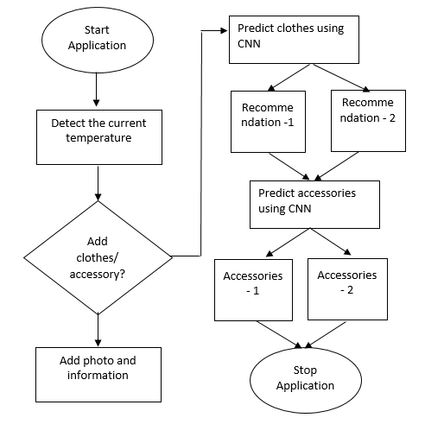
Proposed system (flow chart)
The flow of the system is as displayed in the image.
Step 1: Detecting the weather condition for the location of the user.
Step 2: Predict the clothes which are in the digital wardrobe of the user.
Step 3: Recommendation of the apparel and accessories.

Slide 9
Proposed System (Algorithm and method)
This system used the CNN (Convolutional Neural Network) algorithm to detect the categories, types of the clothes and extracting features from the image.
It will be implemented when the user uploads the image of the clothes from their wardrobe. (categories: t-shirts, pants, shorts, jackets)
To get the type of the cloth, color and which season it will be used in.
These features will be stored in the database, it will be converted into a matrix form (64x64x3) and then the CNN will predict the data.
Where, epoch will be 200 times the data will be learning the item (cloth)

Slide 10
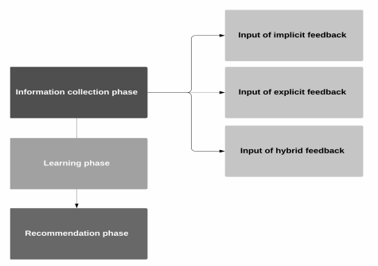
Proposed system (recommendation system)
There will be some phases to implement this system as mentioned below:
Information Gathering (Categories, so on)
Learning Phase (Epoch = 200)
Recommendation Phase
When the user enters all the necessary inputs, the system will help the user to select the apparel with respect to weather condition in the user’s location.

Slide 11
Proposed system (requirements and implementation)
Android Studio Bumblebee 2021.1.1 in Java language. It will an android app for the user.
Web- app is developed by using python language in Jupyter for easy use.
Database for web-app and android app will be SQLite.
The SQLite database will be used for storing the images of clothes and accessories in the system to help the system recommend the apparel for the user.
Both the system will have the basic authentication of Registration and Login to verify and recommend the user of his/her own wardrobe.
For authentication on both the ends, we are using Google Firebase.

Slide 12
Implementation
There are five modules in the implemented system:
Module A: Signup and Login module
The user will signup with his/her personal details and create a password which will be stored in Firebase.
The user must authenticate the email id, by clicking on the link sent by Firebase to the email id entered while registering.
The user has to next Login with the registered credentials which are stored in the database.

Slide 13
Implementation
II. Module B: Creating Wardrobe
Once the user logged in, he/she will be asked to create his/her own database.
By clicking the images of the clothes directly from mobile camera, which will be stored in the SQLite database.
That image will be detected according to the categories, by the help of tensorflow library and specifically by convolutional model which helps in identifying the classification of the cloth.
By using max-pooling model the color of the image will be identified.
By using dense layer model, by the help of categories the cloth type will be identified.

Slide 14
Implementation
III. Module C: Weather API
By using Flask web- framework in python, weather API has been developed.
“global” data is used to get the weather condition for all the location widely.
This API has been created to detect the weather condition for location of the user, by setting the location once logged in.
This will also help the system to identify the clothes for prediction as per the weather condition.

Slide 15
Implementation
IV. Module D: Recommendation of Clothes
Once the weather data is fetched from the API and the prediction is done, the recommendation of the clothes is done.
The data should be trained and learned in according to recommend the cloth, for the location’s weather which also matches with the dataset created by the user at first.
By the help of CNN algorithm, Keras and Tensorflow library specifically VGG model, the data is trained and learnt with the count of Epoch which is set to 200.

Slide 16
Implementation
V. Module E: History
This is one of the module where the clothes will be moved once the user selects to wear the apparel.
This contains the used and the soiled clothes of the user, which is not in the main wardrobe tab, as the user do not want to be recommended by those clothes.
The clothes from this module can be moved back to the wardrobe once washed and ready to use again.

Slide 17
DIFFERENCES
The existing systems used collaborative filtering approaches which has challenges such as cold start system issues, sparsity, and scalability.
Existing system will not help the users with history whereas, in the proposed system the users will be provided with the history of the used or unwanted clothes.
The consistency of the data and the integrity is constantly updated and as the previous systems do not allow the user to update the database.
The existing system only depends on the recommendation system and input from the user whereas our system uses the user’s preferences.

Slide 18
differences
The existing system does not consider weather as a parameter for recommendation, whereas in our system it will be a unique parameter.
Also, the differences are there in methods and algorithms used in the current and the proposed systems.
If we consider the dataset the diversity in the lengths of the users' history/profiles is substantially greater than the lengths of the outfits.
Current system considers the dataset of clothes from online shopping(e-commerce websites) whereas, out system will recommend with the real database of the user created as the user’s own digital wardrobe.

Slide 19
Experiments
We have implemented and explained CNN algorithms in python with the live dataset where 50% is trained and 50% is for test.
In this algorithm, we have particularly used libraries like Tensorflow and Keras.
In Tensorflow library, the models like convolutional, max-pooling and dense layer for classification, compressing and recommendation of the system.
In Keras library, there are various models with which the data handling was a bit difficult, but we have used the VGG model for data input and training.

Slide 20
Experiments
By using the above algorithm, library and models , the accuracy for the system was much better than the algorithm used in the existing systems such as Random Forest, SVM.
So, the data has been trained by 64x64x3 pixels where covers the RGB parameters of the image.
This image will be the cloth image uploaded by the user; whereas in the other algorithm the pixels were not divided in a proper ratio to get the accuracy of the image prediction.
The learning epoch is 200 so that the data is learnt thoroughly and the accuracy % is more, initially the epoch was 20 with not much accuracy as expected.

Slide 21
Conclusion
This system is implemented for the users to help them select the clothing as per the weather condition in their location. We have built a system, for cloth recommendation by using the CNN algorithm with the help of couple of libraries and models of the algorithm. With an accuracy of 85.23% of the model. The dataset has been trained for the best recommendation of the apparel. The preferences, parameters considered in this system is unique, which are all considered together for recommending the best suitable apparel and accessories for the user.

Slide 22
Future Works
The point of fabric can be a future scope in the project.
The user’s fashion sense will be considered for recommendation of the apparel with weather as a parameter.
Updating the database automatically once the user buys some clothes from the e-commerece websites.
Also, considering occasion as a parameter.
Augumented Reality, based on the recommendation the how the user will look before selecting the clothes and accessories for themselves.

Slide 23
references
[1] Y, Lin, K. Yuusuke, S, Etsuko and I, Haruhisa, “Personalized Clothing-Recommendation System based on a Modified Bayesian Network,” International Symposium on Applications and the Internet, 2021, pp. 414–417.
[2] G, Y. Narges, D, Chitra and D, Lorence, Content-based Clothing Recommender System using Deep Neural Network, International Computer Conference, Computer Society of Iran, Tehran, Iran , 2021.
[3] J, Mahir, S, Singh, C, K., R, V. M. and R, V. V., ``Machine Learning Models with Optimization for Clothing Recommendation from Personal Wardrobe ,'' International Conference on Emerging Technologies in Computer Engineering: Machine Learning and Internet of Things, 2020, pp. 12--17.
[4] A, Batuhan, A, I. Mehmet, B, Alkan, T, Erden, D, Mustafa, E, Tolga, ``SMART CLOTHING RECOMMENDATION SYSTEM WITH DEEP LEARNING,'' IEEE, 2019.
[5] K, P. Illa, S, Swathi, Content Based Apparel Recommendation System for Fashion Industry, International Journal of Engineering and Advanced Technology (IJEAT), 2019, pp. 509--516.
[6] C. Samit, H. S. Md., J. R. Naimur, B. C. Manik, B. Deepyan and L. Edgar, 2021. “Fashion Recommendation Systems, Models and Methods: A Review”, MDPI, pp. 1--34.

Slide 24
DEMO

Slide 25
ANY QUESTIONS

Slide 26
THANK YOU

